Slide 1
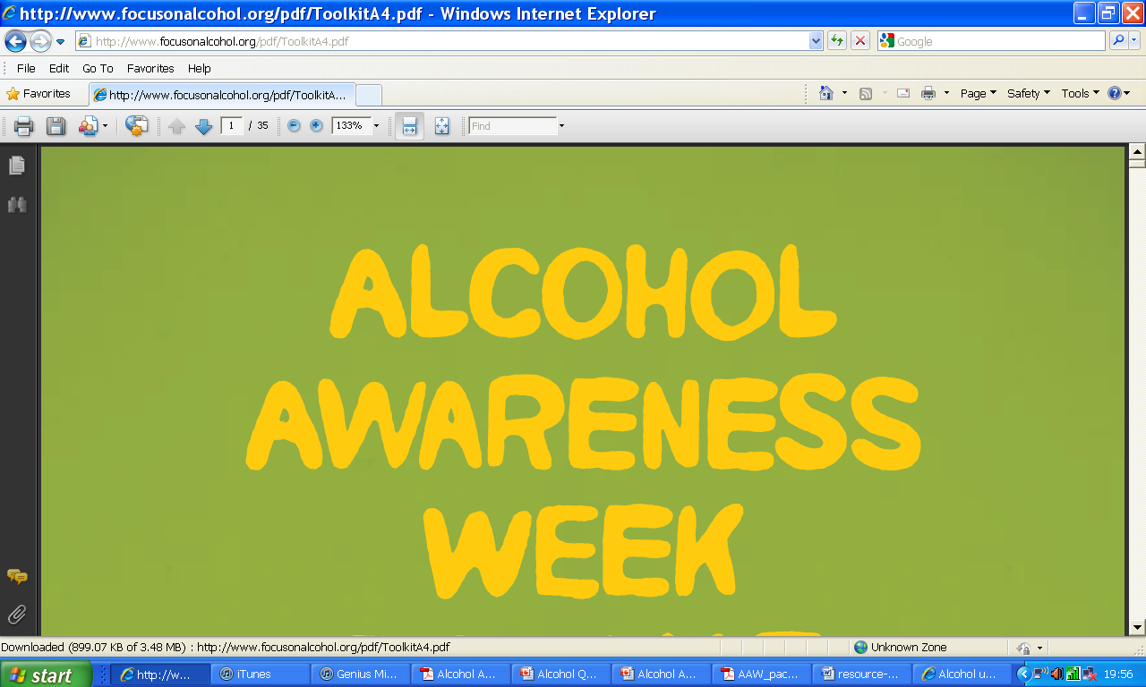
Learning objectives:
Explain why different alcoholic drinks have different strengths or units.
To suggest why it is important to know how strong alcoholic drinks are

Slide 2
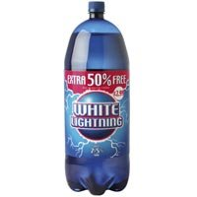
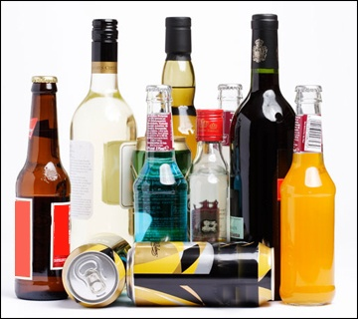
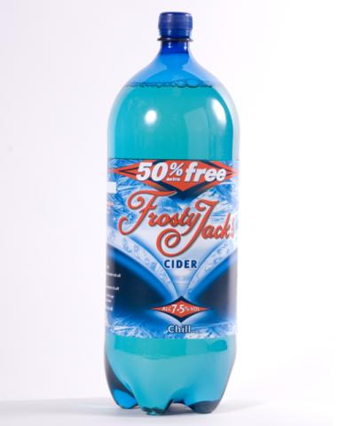
Starter – how many different types of alcoholic drinks can you list in one minute?

Slide 3
What makes one alcohol drink stronger than the other?
The amount of alcohol in a drink is measured by alcohol by volume (ABV) – the percentage of
of pure alcohol in 100ml of liquid.

Slide 4
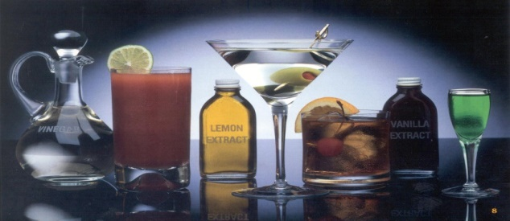
1 unit is 10ml of pure alcohol.
The liver takes one hour to process one unit of alcohol.
The recommended maximum daily intake is 2-3 units for a woman and 3-4 units for a man.

Slide 5
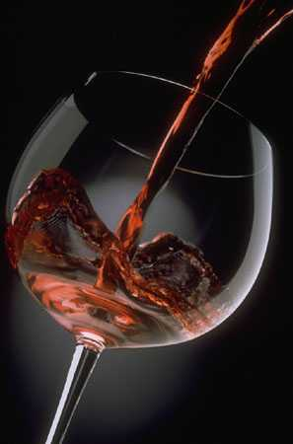
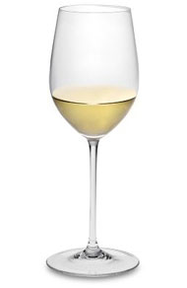
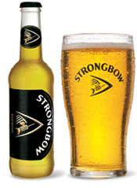
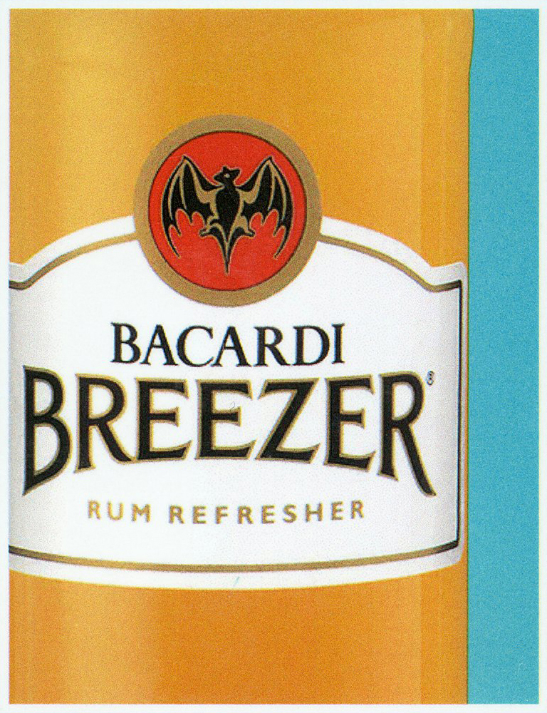
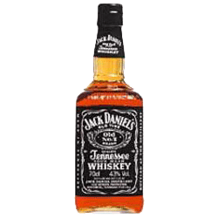
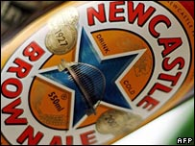
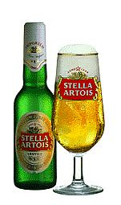
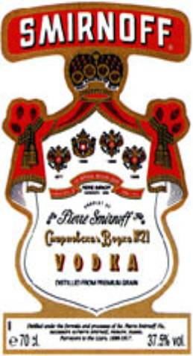
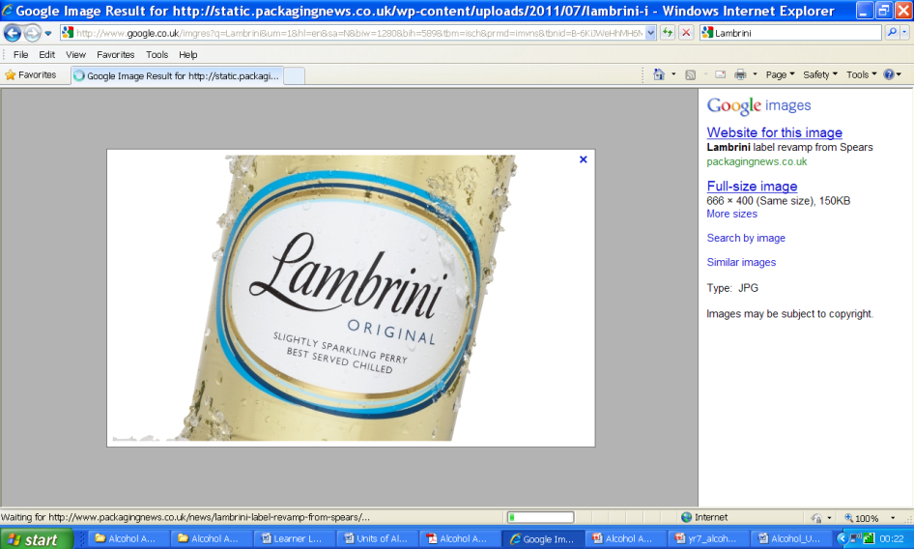
Drinks Sort Activity
Work in pairs to sort the drinks cards that you have been given according to which you think is the one that has the most to least alcohol unit strength . Estimate the number of units per each drink
(250 ml glass) | (125 ml glass) | 1 pint
275ml | Double (50ml) | 1 pint
1 pint | Double (50ml) | 1 large glass

Slide 6
Drinks Sort Activity Answers
Most strong
Alcoholic Drink | Units
250 ml glass of red wine (14%) | 3.5
1 pint Stella Artois (5.2%) | 2.95
1 pint of Newcastle Brown Ale (4.7%)- | 2.67
1 pint of Strongbow (4.5%) | 2.56
250ml Lambrini (7.5%) | 2.06
50 ml vodka (37.5%) | 1.88
125ml glass of white wine (12%) | 1.5
275ml Bacardi Breezer | 1.1
50ml Jack Daniels (40%) | 2.0
Least strong

Slide 7
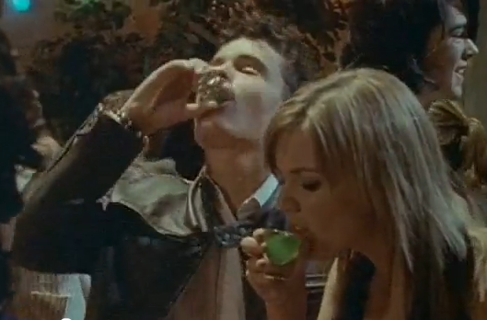
How much is too much?

Slide 8
Read ‘Alcohol – the facts’
Design a poster entitled ‘Think Before You Drink’ to make young people of your age aware of drinking can affect them.

